Slide 1
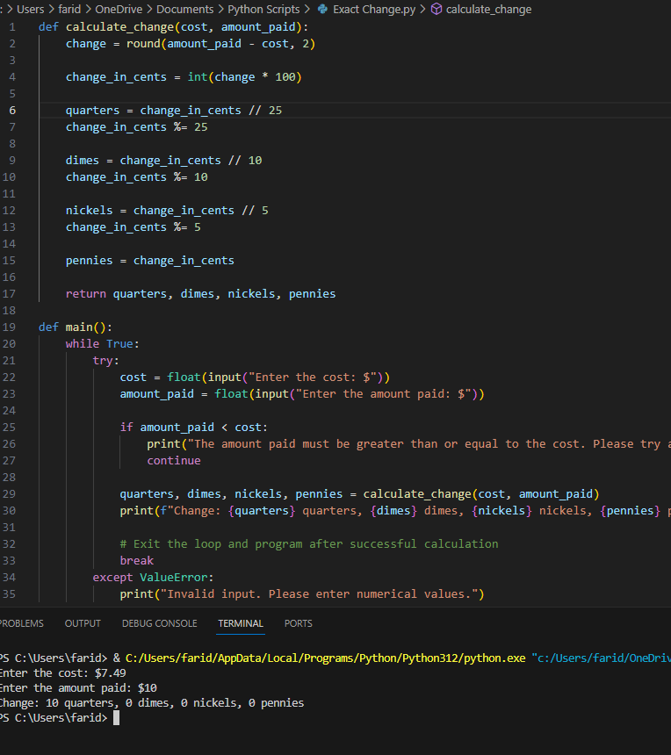
Exact Change Calculator (Farid Aissaoui)
A comprehensive online tool designed to simplify cash transactions by accurately determining the exact change needed. This code aims to enhance efficiency and accuracy in cash handling processes for businesses and individuals alike.
Link to repository: https://github.com/ksu-is/Exact-Change

